Slide 1
SIOP ML Challenge 2024 Results Presentation
Wonderlic ML

Slide 2



The Team
Wonderlic: Unlock People Potential With Predictive Assessments
Guglielmo Menchetti
Senior Machine Learning Engineer
Lea Cleary
Machine Learning Engineer
Annie Brinza
Manager of Data Science and Engineering
Notes:
AB
Headshots
Names
Titles
Emails

Slide 3
Our Approach
What we tried
Why we tried them
Prompt Engineering and ICL
Prompt Tuning
SetFit
Prompt Engineering and ICL
Easy to implement and to use as baseline
Often produces great results
Prompt Tuning
Fine-Tuning on additional datasets
Limited amount of time and resources
SetFit
Small amount of data
Quick training on (relatively) small LLMs
Notes:
Set expectation saying that I’m going more in details with each approach
Started with prompt engineering for those reasons
Moved into prompt tuning after optimizing the prompts to adapt the models to a specialized task
Because of the limited amount of training data and the low scores on Empathy we tried SetFit

Slide 4
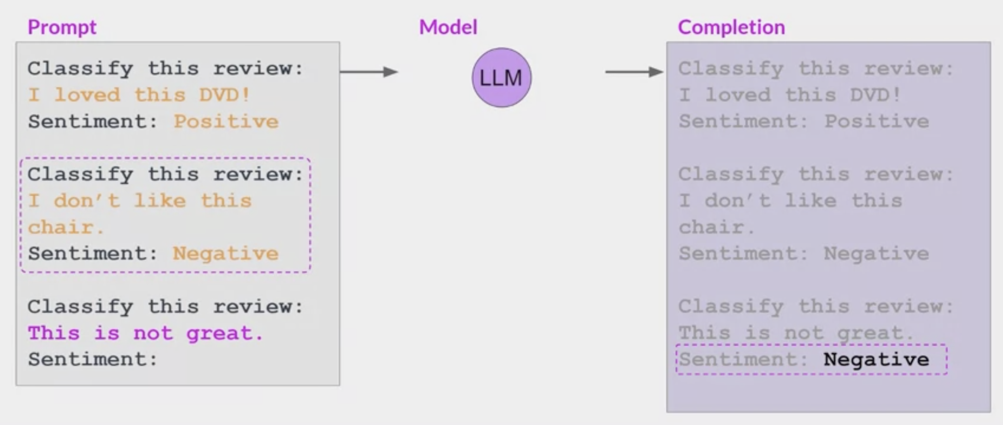
Prompt Engineering and ICL- Overview
Prompt Engineering
Adapt LLMs knowledge and capabilities for a particular task
Design input prompts to elicit the desired response from the LLM
Iterative refinement
Adjust the prompts based on experimentation
Example: trying different phrasing or structure
In Context Learning
Include examples of the task in the input prompt
Additional step: dataset preparation
Source: Coursera - Generative AI with Large Language Models

Slide 5
Prompt Engineering and ICL – ML Competition
Methods we tried
What we learned
Zero-shot and Few-Shot
Few-shot limited by the model’s max input tokens
Clarity, Fairness and Empathy
Used the training data as context examples
Each model required a different prompt
Interview
Interview responses from the same person as context
Personality data
Multiple iterations needed on the input prompts
Few-shot led to the best results
Overall GPT4 performed as the strongest baseline
Instruction Fine-Tuned models performed better than foundation models
Flan T5 and Mistral 7B couldn’t get all the examples as input
The results for Clarity were the most difficult to generate properly
Models we tried
GPT4 Turbo
Flan T5
Mistral 7B
Notes:
Each model needed multiple iterations to get to the desired outputs

Slide 6
Prompt Engineering and ICL – Interview
Adding personality in interview
What we learned
Used in the Few-Shot setting
Added the personality scores and/or representation as additional context
Personality as raw score
“You scored 3.5 out of 7 on Openness, 4 out of 7 …”
Personality as buckets
Three buckets: Low-Medium-High
“You scored moderate on Openness, high on …”
Personality as buckets and interpretation
Three buckets: Low-Medium-High
“You scored moderate on Openness which means that…”
Achieved the best results using personality with bucket and interpretations with GPT4
Full personality description could not be used for all models
Different uses of personality only marginally changed the obtained results

Slide 7
Prompt Engineering and ICL– GPT Prompts
System Message all but Interview: "You are an Industrial-Organizational Psychologist.”
System Message Interview: "You are a job candidate and you are responding to behavioral questions during an interview.”
Empathy
Clarity
User: “Job candidates were asked to provide empathetic responses to a difficult workplace situation. Classify whether empathy was demonstrated or not. Only respond with 0 (no empathy) or 1 (empathy). [TEXT 1]”
Assistant: “[LABEL 1]” …
User: “[TEXT N]"
User: “Respondents rated the clarity of personality test items using a 7-point scale from 1 = extremely unclear to 7 = extremely clear. Your task is to rate the clarity of the following item from an industrial-organizational psychology perspective. Respond with a rational number between 1 and 7. [ITEM TEXT 1]”
Assistant: “[LABEL 1]” …
User: “[ITEM TEXT N]"
Fairness
Interview
User: "Respondents compared two organizational policies and voted on which was fairest. Identify which policy received the majority vote as the fairer option. Answer only with 'first' or 'second', even in uncertainty. 'Both' as a response is not valid.
First=[FIRST TEXT 1] – Second=[SECOND TEXT 1]”
Assistant: “[LABEL 1]” …
User: “First=[FIRST TEXT N] – Second=[SECOND TEXT N]”
User: " You scored moderate on Openness which means that … You will be provided with questions and answers you already answered in between ### markers. You will need to answer the last question in a consistent style, using less than five sentences.
### Question: [QUESTION 1] – Response: [RESPONSE 1] ###... ### Question: [QUESTION N] – Response:”

Slide 8
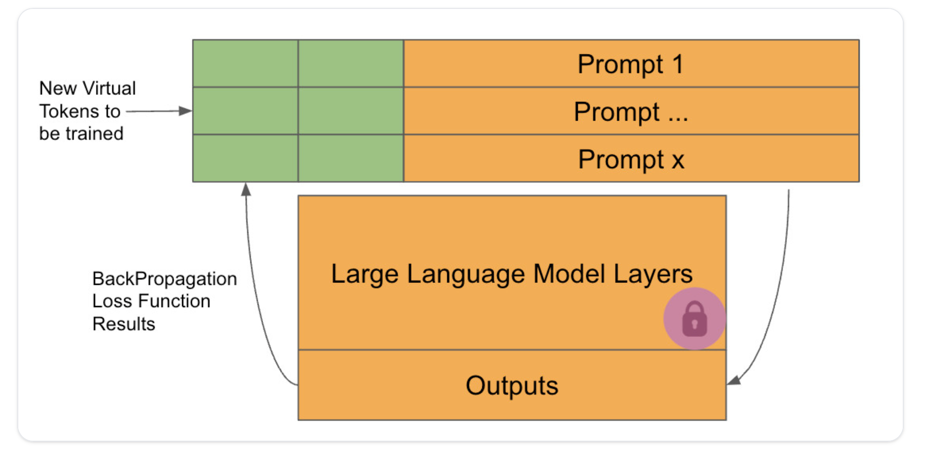
Prompt Tuning - Overview
What is it
Soft Prompting method
Adapt the model to a downstream task
Add a small amount of learnable parameters to the input embeddings
Keep the pretrained LLM parameter's frozen
Sequence Classification
Cast the problem as a next token generation
Prompts are added to the input as a series of tokens
Train the model for a Causal LM task
Source: Hugging Face - https://huggingface.co/learn/cookbook/prompt_tuning_peft
Pros
Cons
Few parameters to train
Fast adaptation to specialized tasks
Efficient resource utilization
Lack of interpretability of the tuned prompts
Notes:
Prompt engineering didn’t work with Clarity, that’s why we tried this approach

Slide 9
Prompt Tuning - ML Competition
What we tried
What we learned
Model trained on QA and Entailment external datasets
Zero-shot on Empathy and Fairness
Didn’t work as expected
Model trained on SIOP data as a QA and Entailment problems
Entailment: Empathy and Fairness (+ additional data), unified datasets and separate
QA: All tasks separate
Models
BLOOMZ (560M, 1.1B, 7B)
GPT2 Medium
LLaMa2 7B
Prompt-Tuning for separate tasks outperforms unified tuning
The prompt tuned models perform well for their small size
Achieved the best results for the Clarity sub-challenge
Prompt-Tuning on a different dataset didn’t help
Quantization for big models underperformed compared to smaller models without it
Prompt-Tuning was not effective at all for Interview

Slide 10
Prompt Tuning - Data formats
Input data format
Entailment - Hypothesis
Empathy ”The premise demonstrates an empathetic response to a difficult workplace situation.”
Fairness “The first option was voted by the majority of respondents as the fairer organizational policy.”
Question Answering - Question
Empathy “Does the passage demonstrate an empathetic response to a difficult workplace situation?”
Fairness “Was the first option voted by the majority of respondents as the fairer organizational policy?”
Clarity “What is the average clarity rating on a scale of 1-7 of the personality item?”
Interview “Job candidates responded to four common interview questions. You will be given the text of three question and response pairs as reference. Your task is to generate a likely text response for the last question based on the previous responses.”

Slide 11
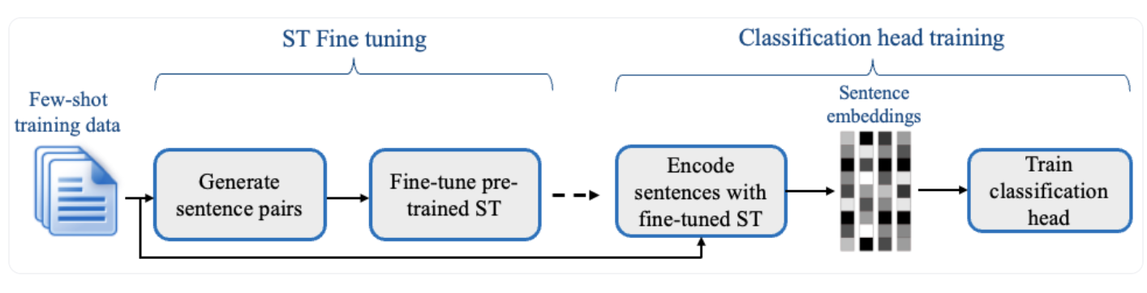
SetFit: Efficient Fine-Tuning of Sentence Transformers
What is it
How it works
Fine-Tuning of Sentence Transformer model
Few-shot learning
Small amount of data
Leveraging prior knowledge
Contrastive Learning
Learn differences between similar/dissimilar pairs
Create pairs of similar or dissimilar items
Source: Efficient Few-Shot Learning Without Prompts - https://arxiv.org/pdf/2209.11055.pdf
Pros
Cons
Only few datapoints needed
Save time and resources
Results are comparable but not the same as training on a big dataset
Notes:
Prompt engineering and prompt tuning was working decently but with after some research we decided to try this technique that works well with few-shot data

Slide 12
SetFit – ML Competition
What we tried
What we learned
Only tried on Empathy
Created sentence pairs
Pairs: 420
Validation: 8 samples
Hyperparameter tuning
Number of epochs
Learning rate
Models
MPNET
BART-Large
Quick training and small use of resources
Achieved the best results on the Empathy sub-challenge
Hard to validate with small amount of data
Couldn’t work on the other sub-challenges

Slide 13
Final Models
Empathy
Fairness
SetFit Fine-Tuning
BART-Large
Hyperparameter tuning
Score: 0.1225
In-Context Learning
GPT4 – Full-Shot
Temperature: 0
Score: 0.19828
Interview
Clarity
In-Context Learning
Personality with buckets and interpretation
GPT4
Temperature: 1
Score: 0.11539
Prompt-Tuning
Ensemble of models
BLOOMZ 1B + GPT2 Medium
Score: 0.19346

Slide 14
Learnings/Takeaways
Great chance to explore possible uses of LLMs
Prompt Engineering and ICL are easy to setup and use as first models
GPT4 was the easiest one to setup
Most reliable outputs
Worth paying for the API access
Prompt-Tuning allows to save on resources
Still requires time to train the models
Easy to setup using the PEFT Library (Huggingface)
SetFit easy solution when few datapoints are available
Easy to setup using the SetFit Library (Huggingface)
Notes:
Prompt Engineering and ICL
GPT4 was the easiest to work with and could be worth paying for the API use
Prompt Tuning – Save on resources, but still requires time to train the models
SetFit – easy solution when few data is available

Slide 15
Thank you for your attention

Slide 16
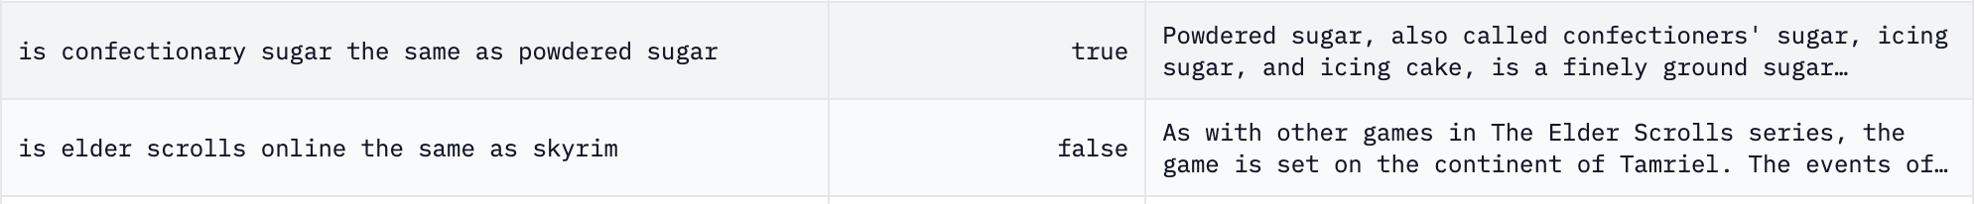
Appendix A
Prompt Tuning using external data
Check if prompt-tuned models could be transferred to Fairness and Empathy tasks
Prompt Tuned LLaMa2-7B with 100 tokens
Two datasets
BoolQ – Question Answering
Around 9k examples
Passage-Question pairs with “yes”/”no” labels
RTE
Around 2.5k examples
Premise-Hypothesis pairs with “entailment”/”not entailment” labels

